Slide 1
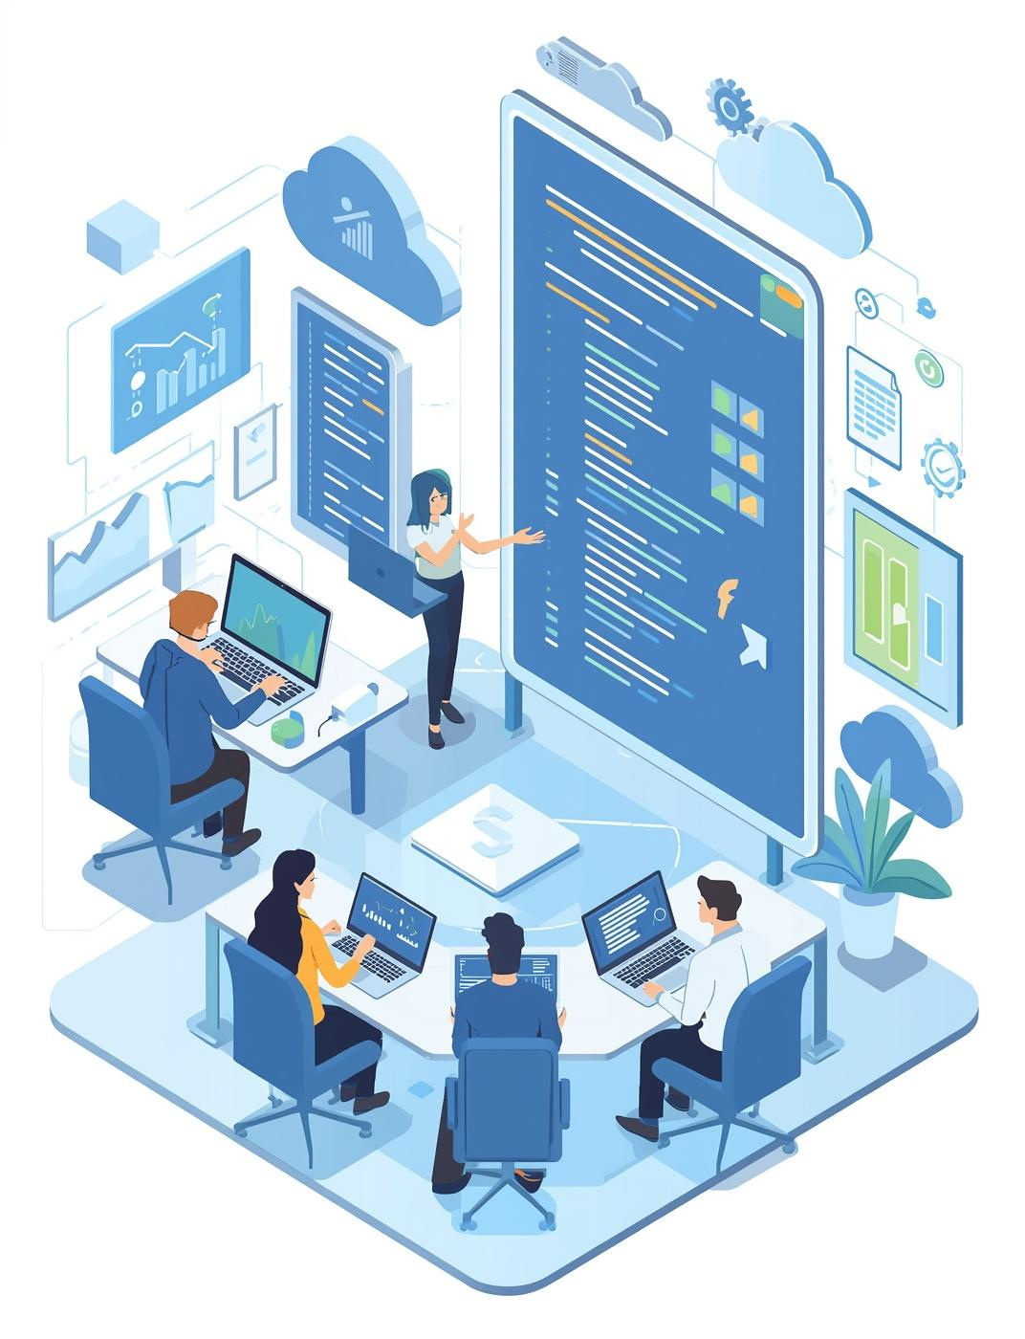
Tracking-System-Application Presentation
DevOps Insights and Technology Stack Overview
Saketh Vishwanatham, Gollakota Satya Kartik

Slide 2
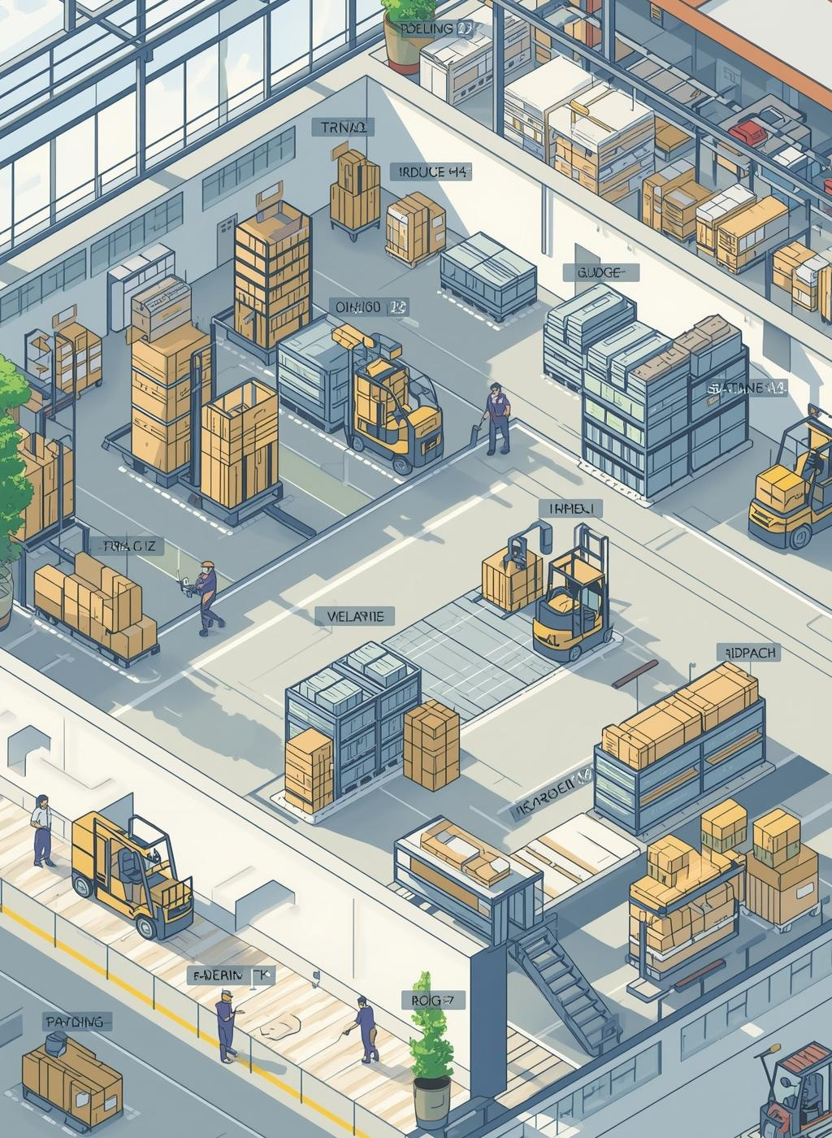
Problem Statement
In the fast-growing Indian e-commerce and logistics landscape, customers, logistics teams, and administrators face challenges in real-time shipment tracking, delivery coordination, and system visibility.
Traditional systems often lack automation, scalability, and end-to-end monitoring, leading to delays, manual errors, and poor customer experience.

Slide 3

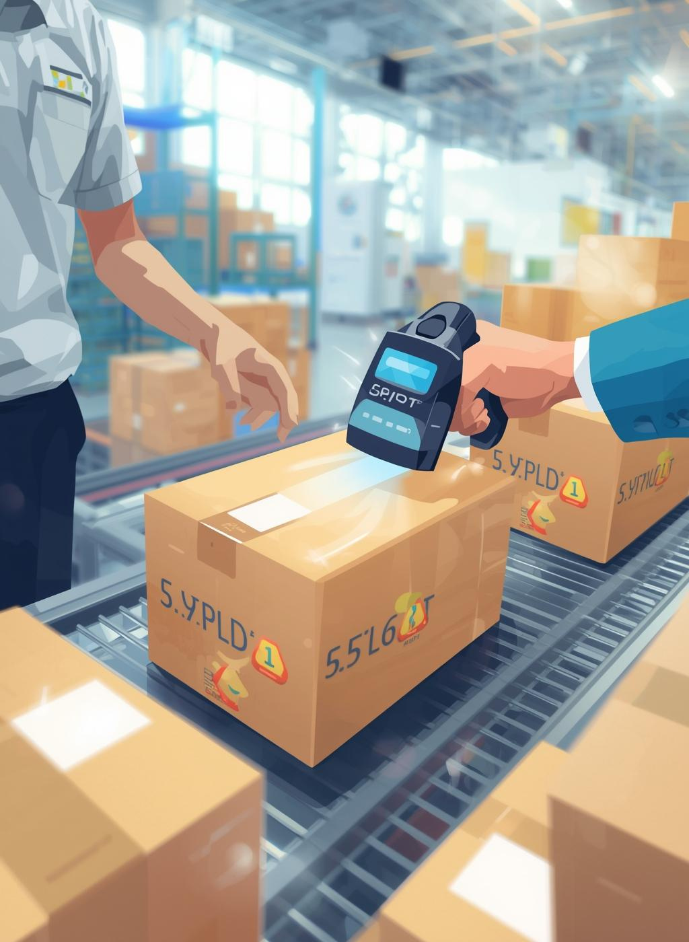
Project Overview
Introduction to the Tracking-System-Application
Tracking-System-Application enhances shipment visibility for customers, logistics teams, and admins in the e-commerce space.
It connects every corner of Bharat with reliable delivery and advanced tracking.

Slide 4

Tracking-System-Application: Importance of Tracking
Pan-India Coverage
Same-Day & Hyperlocal Delivery:
Digital & Cash Payments:
End-to-End Logistics:
Connects 28 states and 8 union territories with 500+ service centers for nationwide reach.
Supports UPI, digital wallets, and cash on delivery for seamless transactions.
Includes warehousing, API-based e-commerce integration, rural delivery, and festival-special services.
Offers 2–4 hour intra-city delivery and guaranteed same-day service before 9 PM.

Slide 5
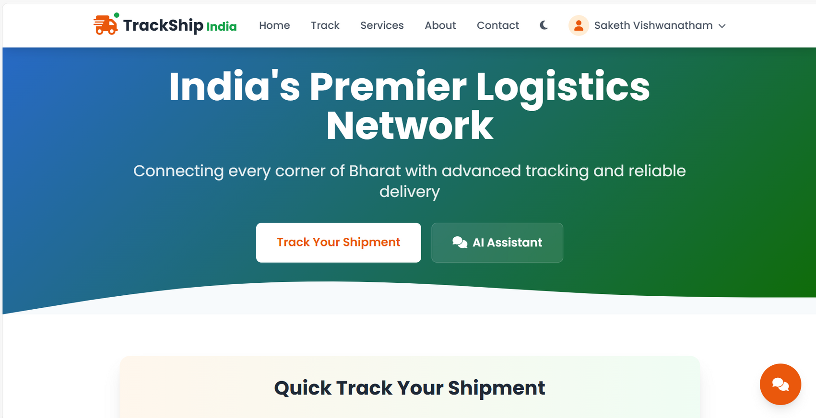
Application

Slide 6
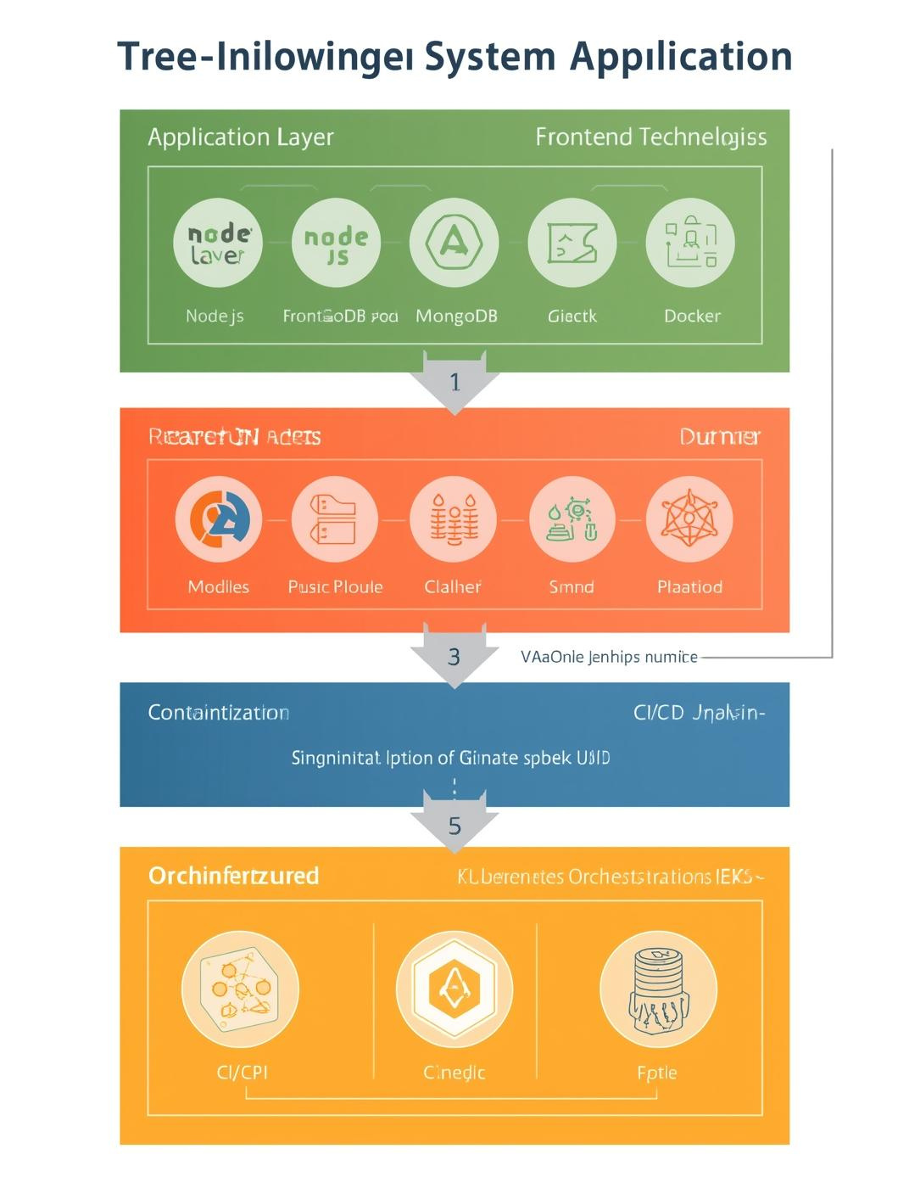
Architecture and Technology Stack
Overview of system components and their interactions
The architecture of the Tracking-System-Application integrates multiple technologies, ensuring seamless operation.

Slide 7
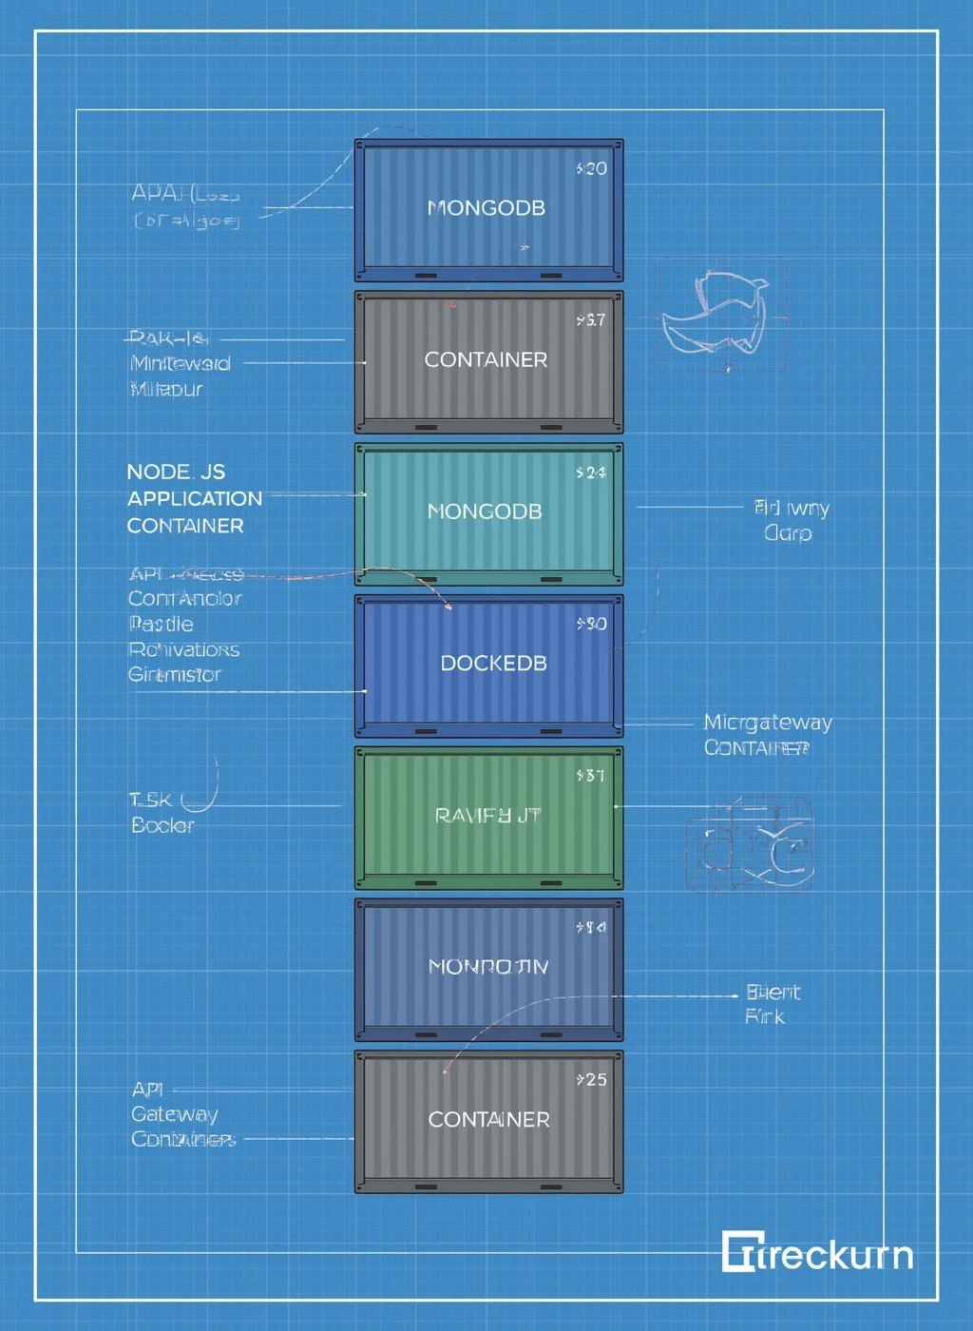
Technologies, Tools, and Components
Application Layer: Node.js, HTML, CSS, JavaScript
Database Layer: MongoDB, MongoDB Compass
Containerization: Docker, Docker Compose Docker Hub
Container Orchestration : Kubernetes (K8s), Deployments, Config via YAML
CI/CD Pipeline: Jenkins
Cloud / Infrastructure: AWS EC2
Monitoring and observability tool: Grafana, Prometheus

Slide 8
Deployment Flow
Developer → pushes code to GitHub
Jenkins CI/CD → builds Docker image using Dockerfile
Terraform → provisions AWS infrastructure (EC2, EKS, networking)
Image Pushed → to AWS ECR / DockerHub
Kubernetes (EKS) → pulls image & runs container
Service + LoadBalancer→ exposes Bookstore App to users
MongoDB Pod/Service → stores users, login, cart, articles
Prometheus → collects metrics (CPU, memory, pods, requests/sec)
Grafana → visualizes metrics & builds dashboards

Slide 9
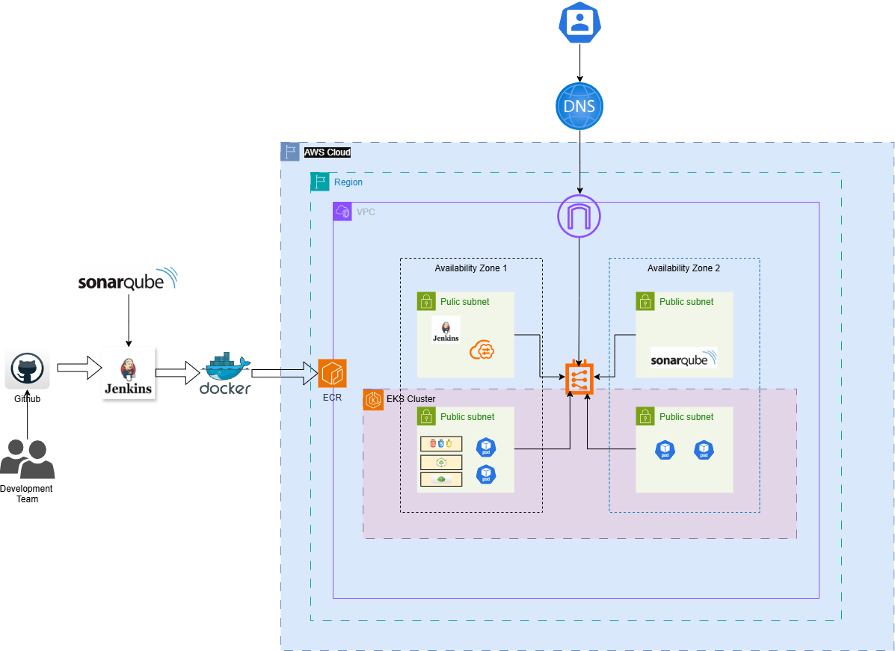
Infrastructure

Slide 10
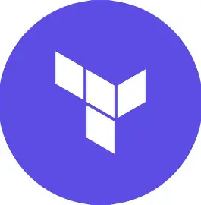
Terraform
Infrastructure as Code
Terraform is an open-source Infrastructure as Code (IaC) tool developed by HashiCorp. It allows you to define, provision, and manage cloud infrastructure using simple, declarative configuration files written in HCL (HashiCorp Configuration Language).
Cloud Infrastructure (AWS)
Amazon ECR (Elastic Container Registry): Stores Docker images built by Jenkins.
Amazon EKS (Elastic Kubernetes Service): Manages Kubernetes clusters for container orchestration.

Slide 11
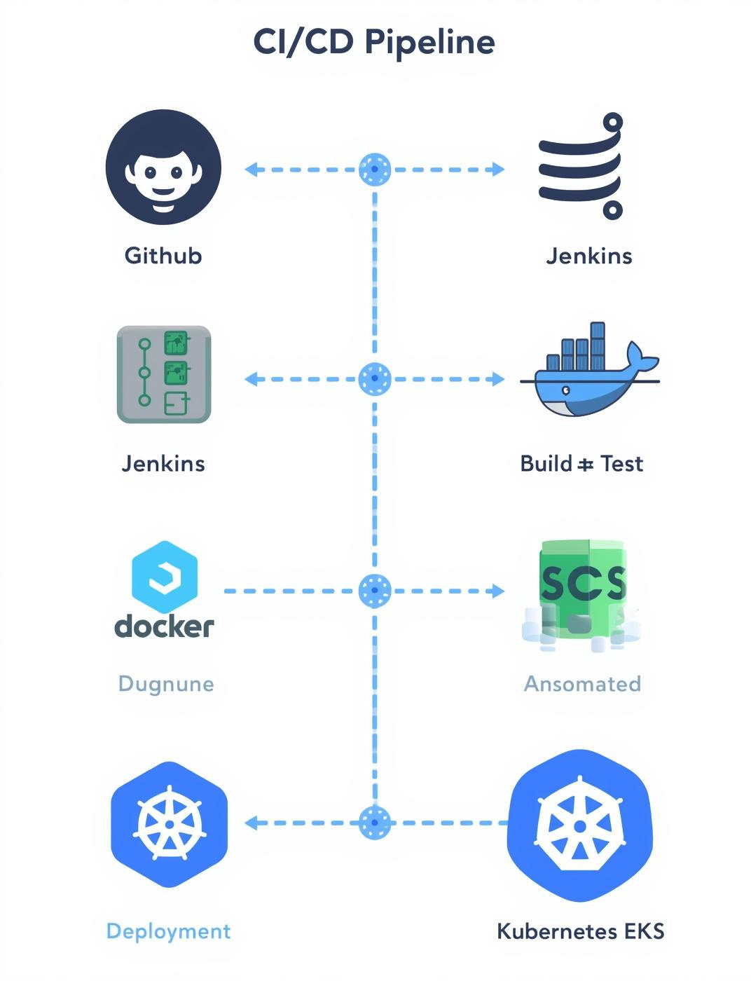
Jenkins in the CI/CD Pipeline
Jenkins is an open-source automation server that plays a central role in the CI/CD (Continuous Integration/Continuous Delivery) process.
Continuous Integration (CI)
Automatically builds and tests code whenever a developer pushes changes to GitHub.
Ensures code quality and prevents integration issues early.
Continuous Delivery (CD)
Packages the application into a Docker image using a Dockerfile.
Pushes the image to a container registry like DockerHub or AWS ECR.
Triggers deployment to Kubernetes (EKS) using configuration files.

Slide 12
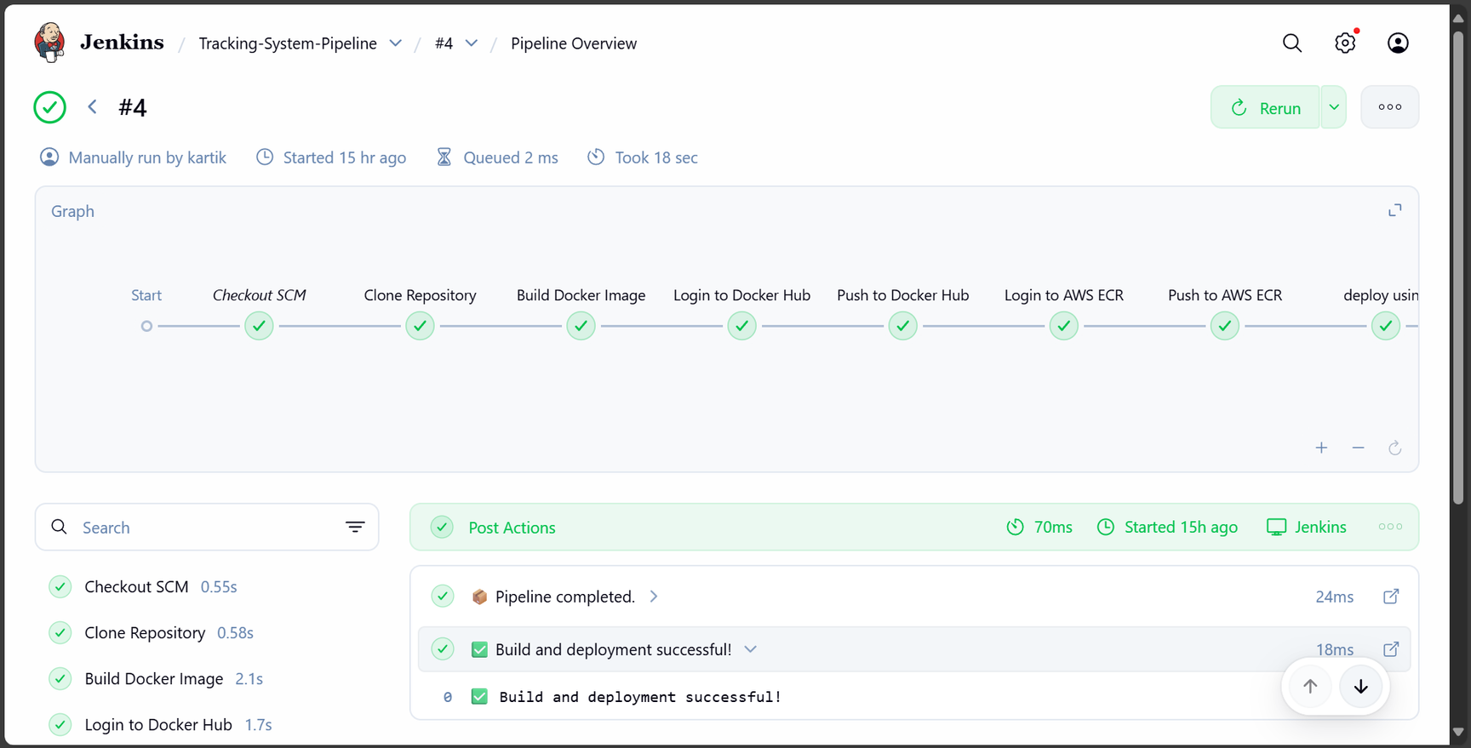
Jenkins Pipeline

Slide 13
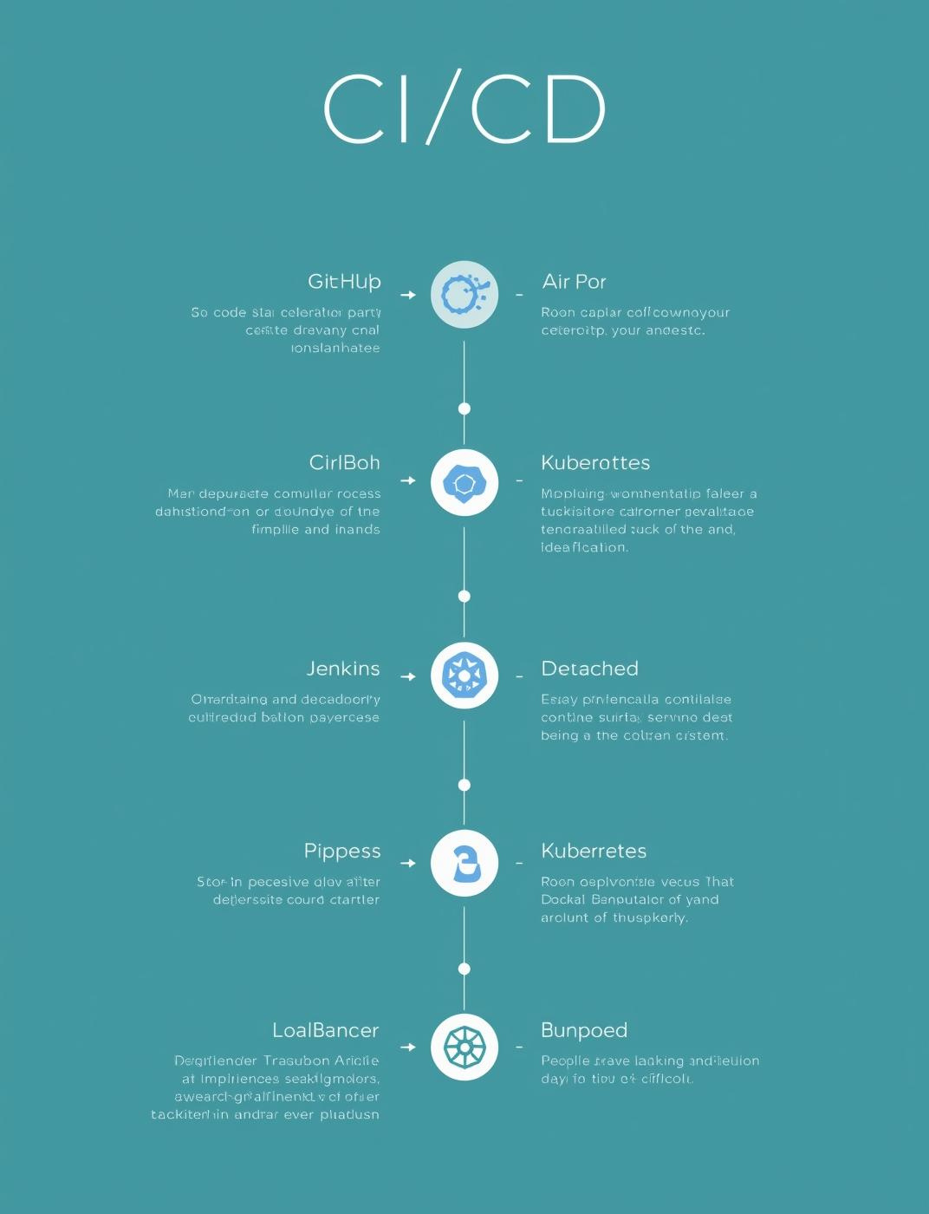
Containerization
Containerization allows applications to run consistently across different environments by packaging code, dependencies, and configurations into lightweight containers.
Docker
A platform to build, run, and manage containers.
Uses a Dockerfile to define how the container is built (e.g., Node.js app + MongoDB).
Container Orchestration: Kubernetes (K8s)
Kubernetes automates deployment, scaling, and management of containerized applications.
Deployments
Define how many replicas (pods) of your app should run.
Automatically restarts failed containers and handles rolling updates.
Configuration via YAML
Kubernetes resources (pods, services, deployments) are defined using .yaml files.
YAML allows declarative configuration—easy to version control and automate.

Slide 14
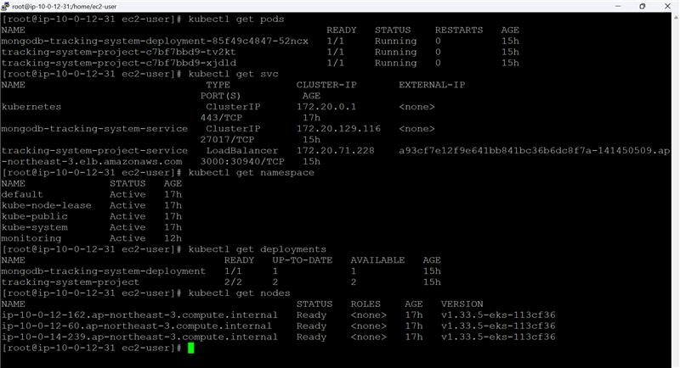
EKS cluster

Slide 15
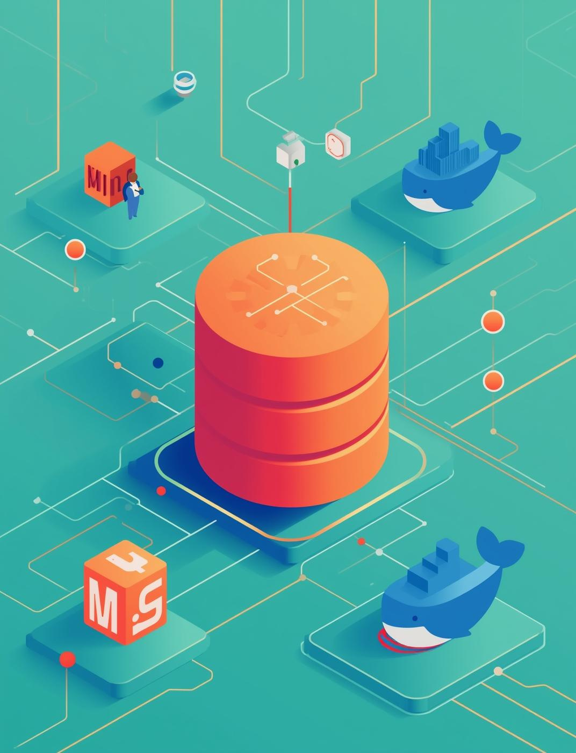
DevOps Monitoring
Prometheus: Metrics Collection
Prometheus is an open-source monitoring tool designed for time-series data.
Stores data in its own TSDB (Time Series Database).
Ideal for tracking:
CPU & memory usage
Pod health
Request rates
Container uptime
Grafana: Visualization & Dashboards
Grafana is an open-source analytics and visualization platform.
It connects to Prometheus (and other data sources) to display metrics in real-time dashboards.
Helps DevOps teams:
Monitor system health
Detect anomalies
Set up alerts
Share insights with stakeholders

Slide 16
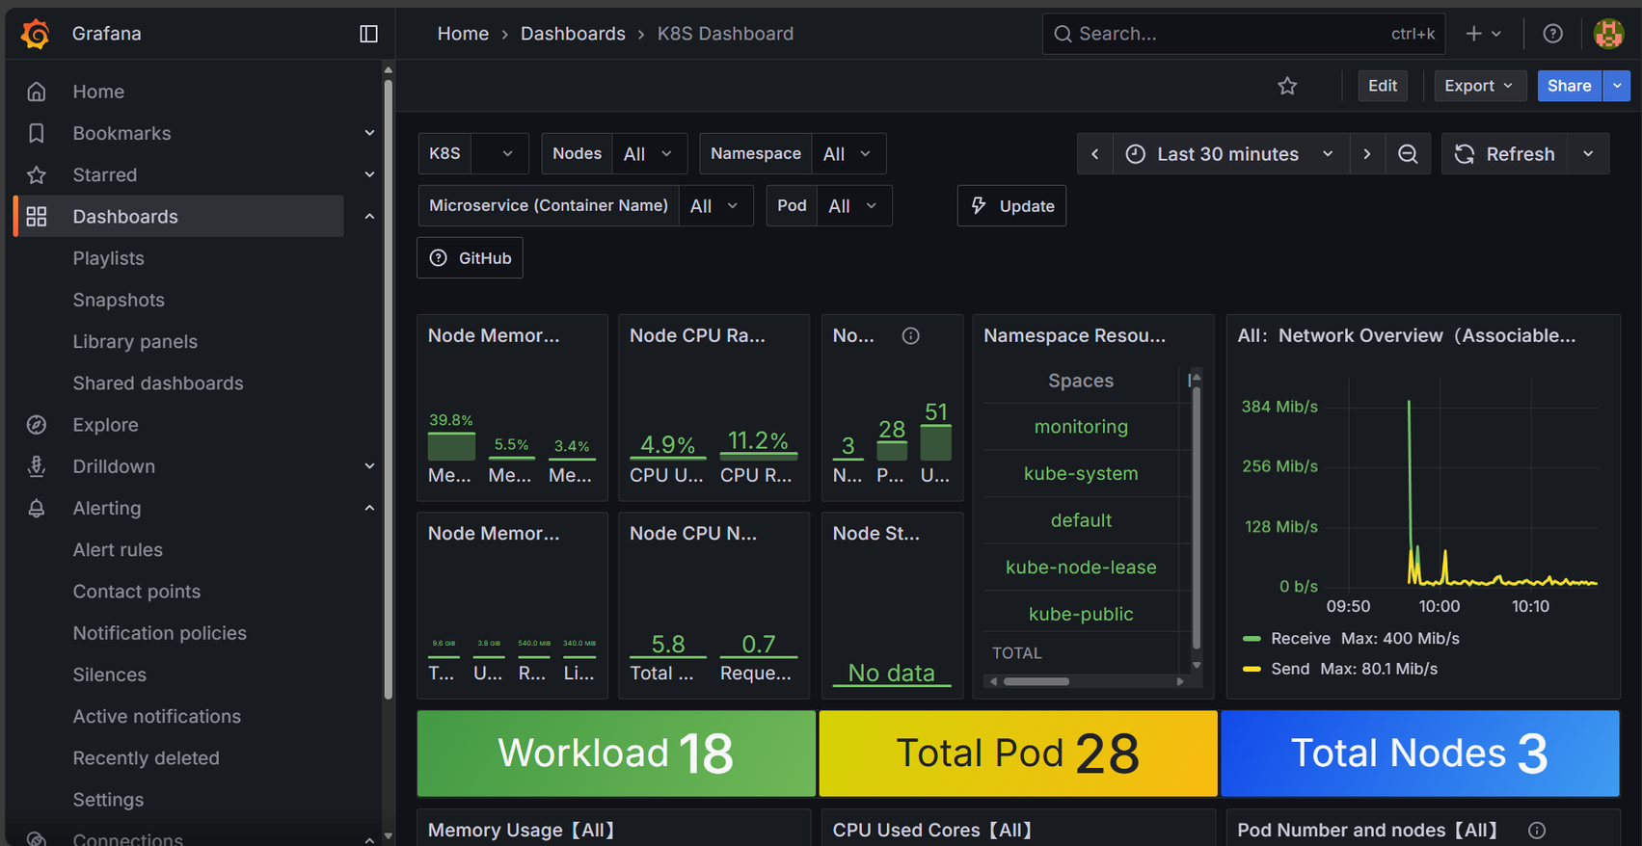
Grafana dashboard

Slide 17

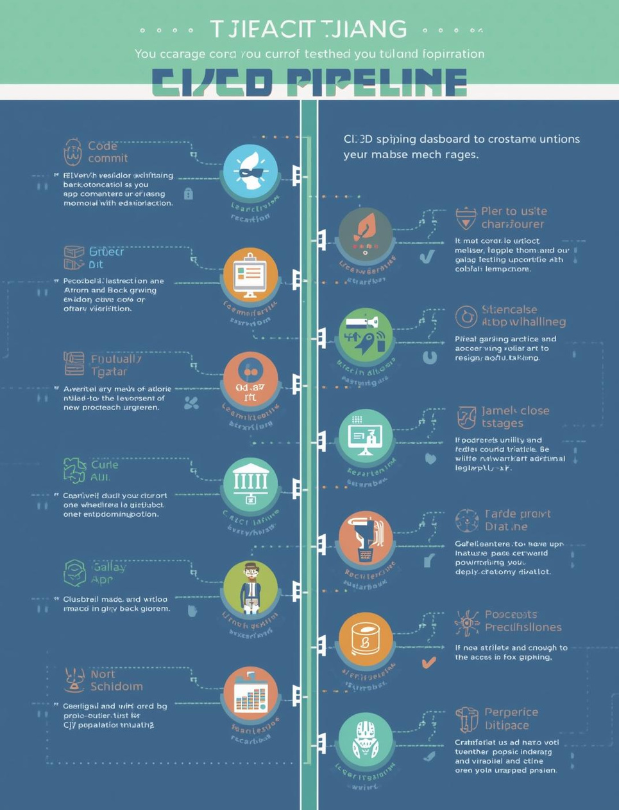
Advantages of the Application & Tech Stack
Faster Incident Resolution
Real-time monitoring with Prometheus & Grafana
Integrated alerting and issue tracking via ServiceNow
Automation = No Manual Delays
CI/CD with Jenkins automates build, test, and deployment
Auto-assignment of issues and tasks reduces human error
Seamless Team Collaboration
DevOps bridges support, inventory, and checkout teams
Shared visibility and faster feedback loops
Complete System Visibility
Prometheus collects metrics
Grafana visualizes dashboards
Robust User Experience
Secure User Registration/Login with MongoDB
Smooth Catalog Browsing, Cart Management, and Checkout
Community Engagement with articles and AI chatbot support

Slide 18
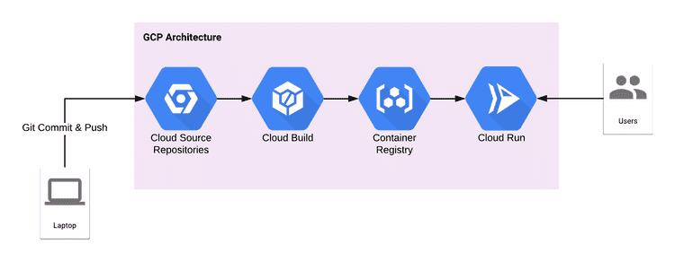
CI / CD in Google Cloud Platform

Slide 19
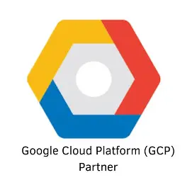
GCP Tools
Cloud Build: Builds and tests your code automatically on every commit.
Cloud Deploy: Manages automated deployments to GKE, Cloud Run, or Compute Engine.
Artifact Registry: Stores and manages build artifacts like Docker images securely.
Cloud Run: Runs containerized applications in a fully managed, serverless environment.

Slide 20

Thank You

